Slide 1
Blog Page Using Django

Slide 2
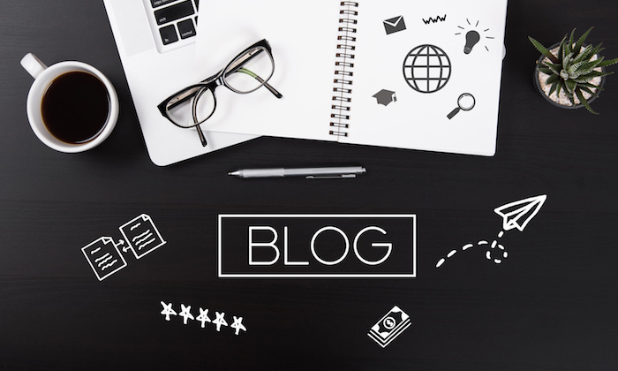
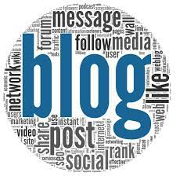
What is blogging?
A blog is a discussion or an informational website which is published on the internet

Slide 3
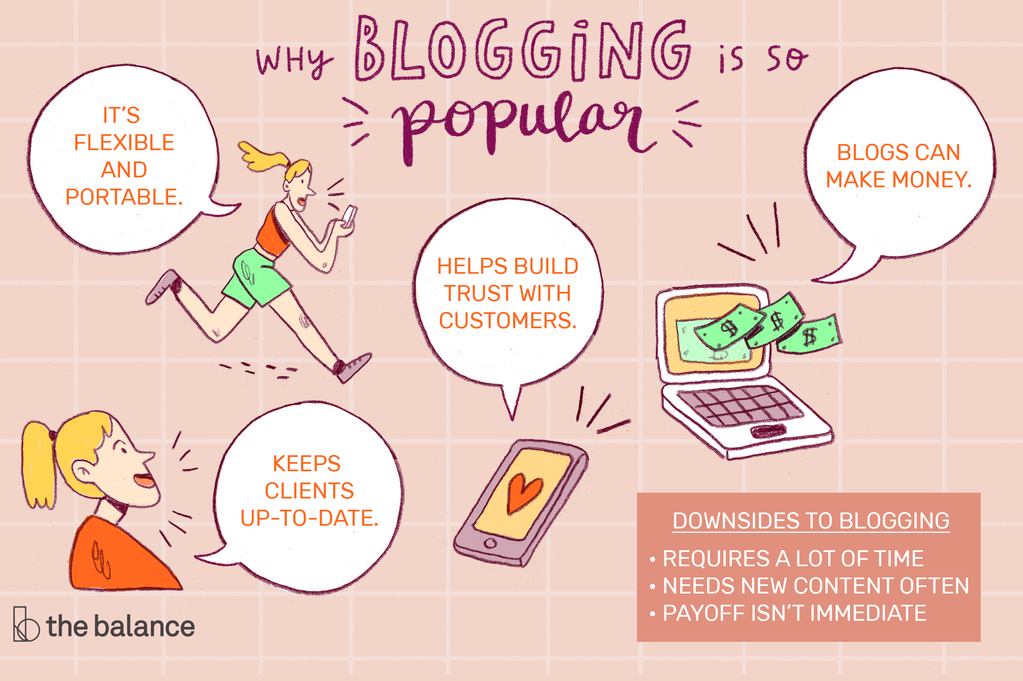
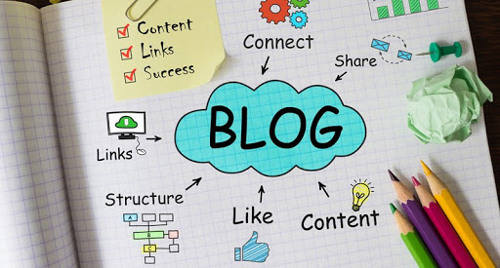
PURPOSE
Blogging has different purposes like:
Providing information to people.
Establishing a person as an authority.
Share your thoughts and opinion with other people.
Blogging tends to provide more exposure and also helps in improving business by increasing reach.

Slide 4
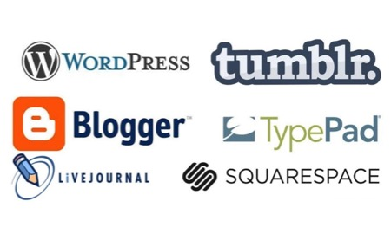
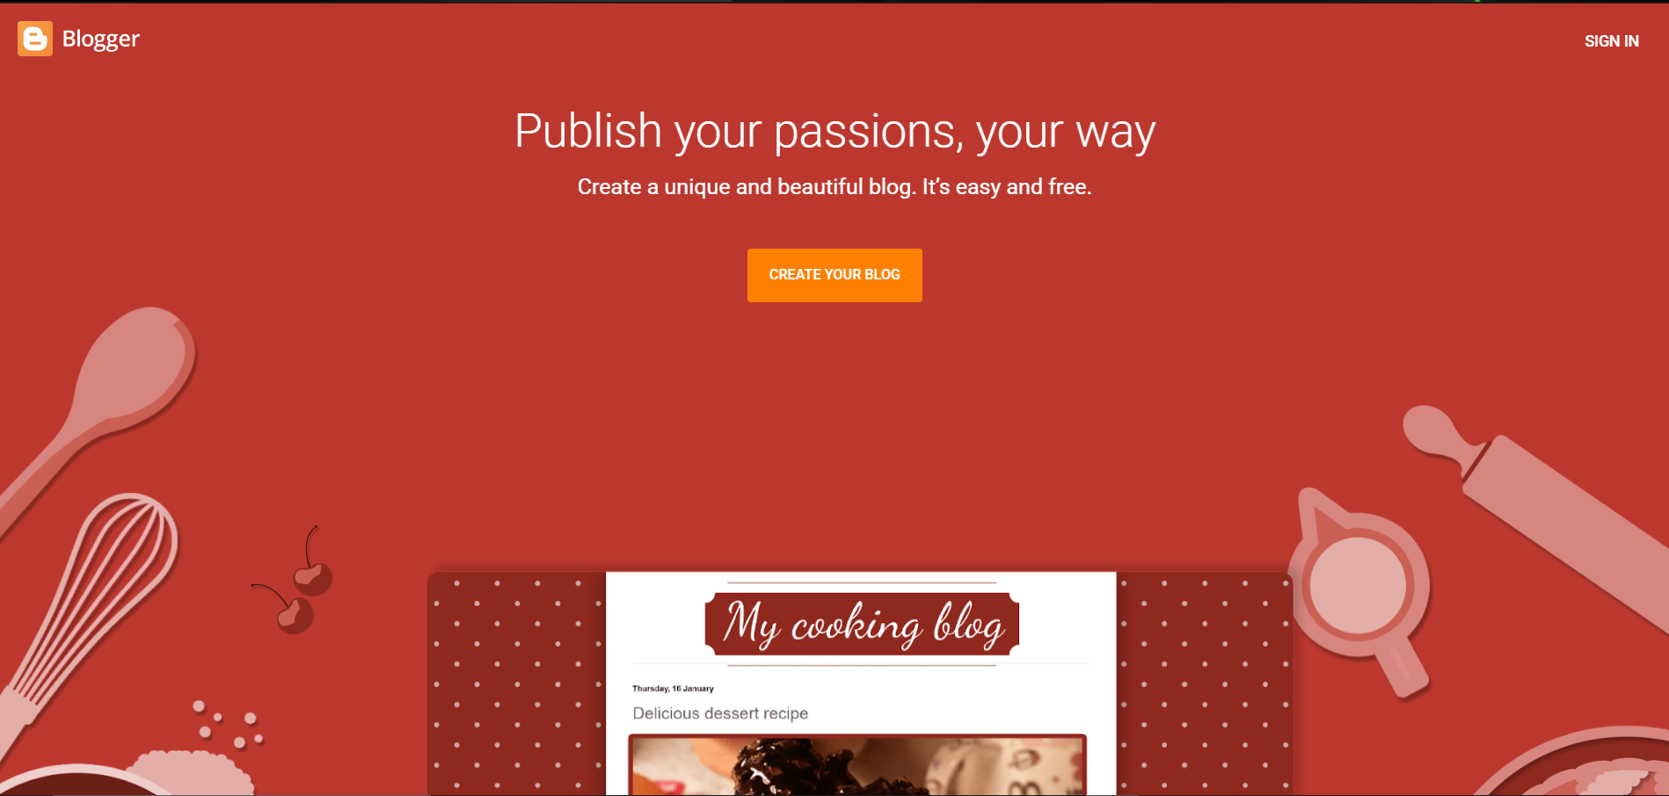
Available existing systems
There are a number of available blogging platforms online:
Blogger:

Slide 5
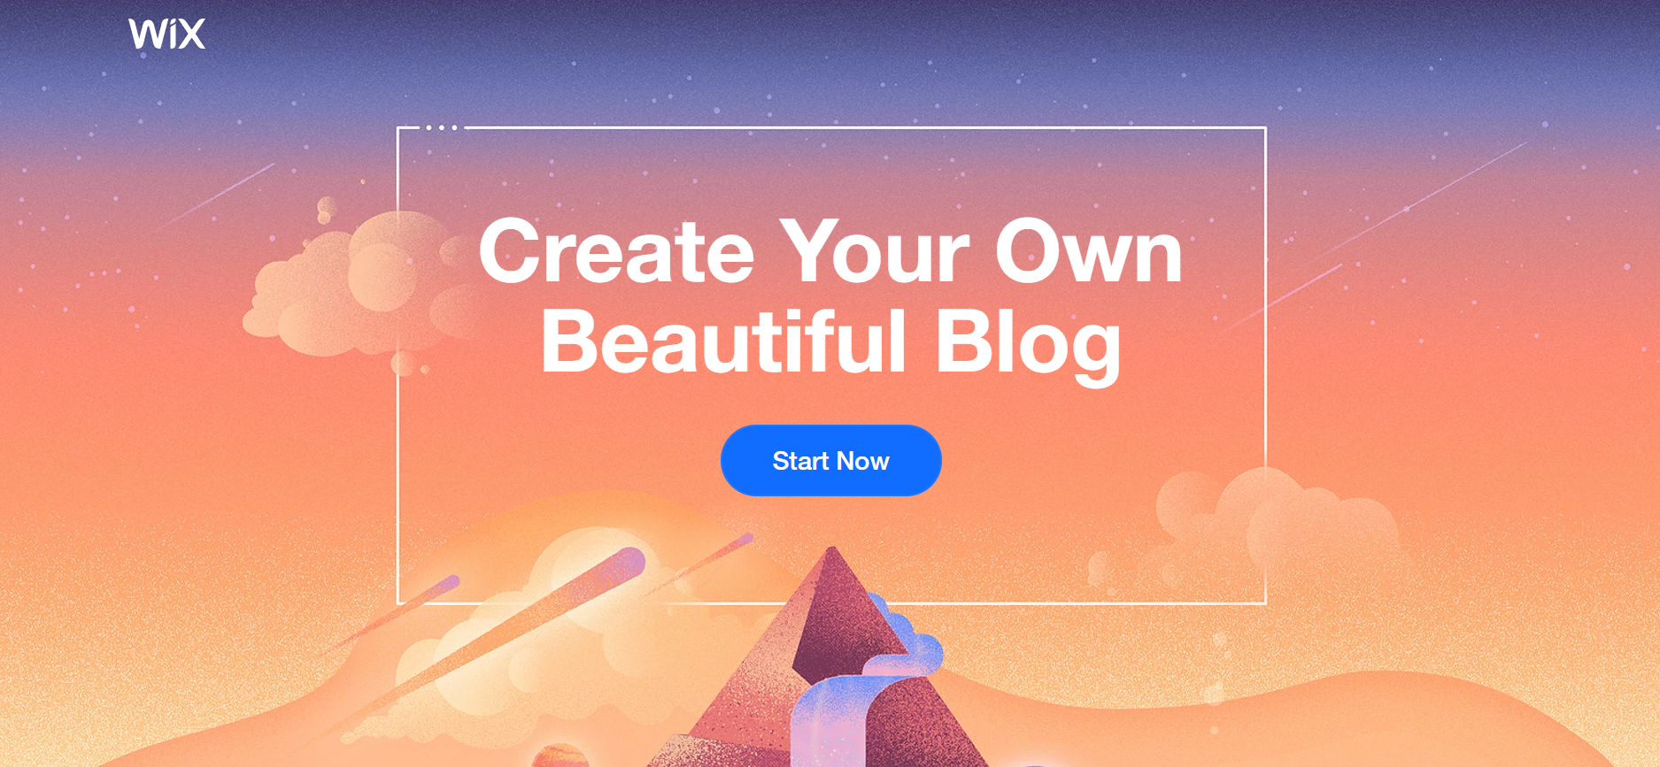
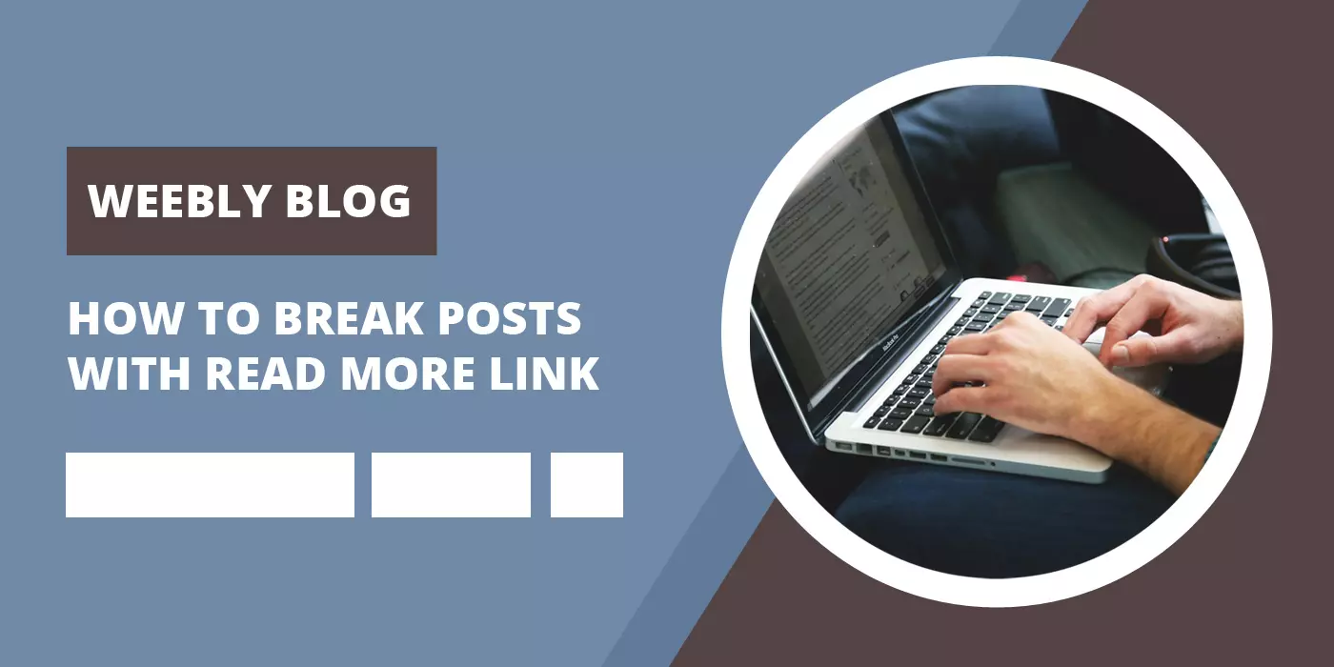
Wix:
Weebly:

Slide 6
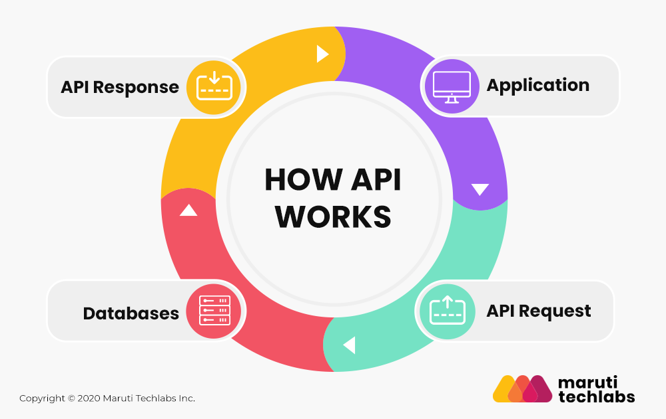
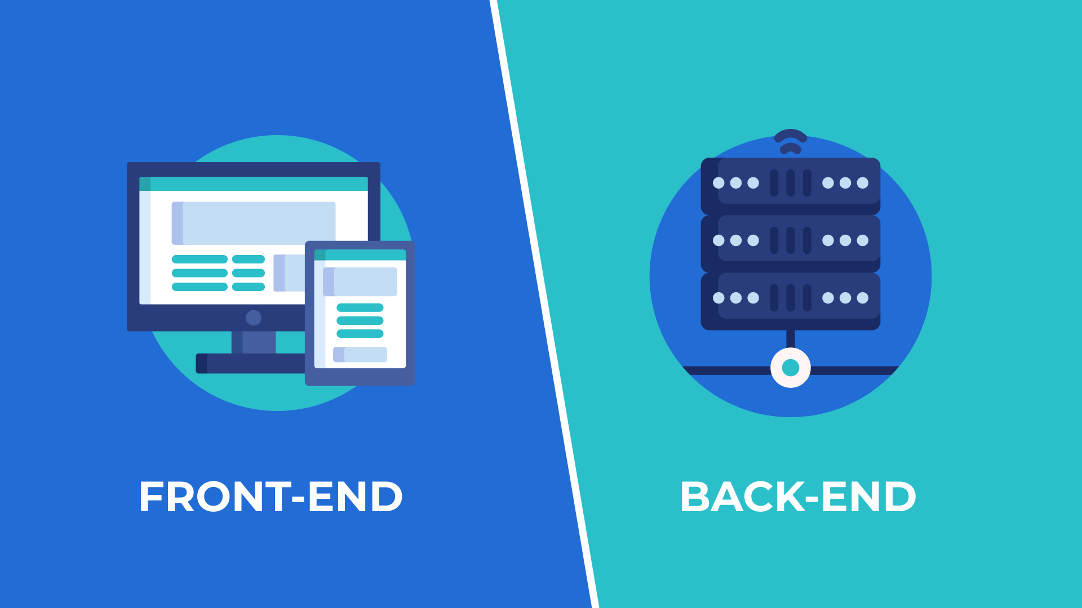
Novelty in this solution
This is a complete backend API which any front-end developer can customize.
This API provides flexibility and ease to the front end programmer.

Slide 7
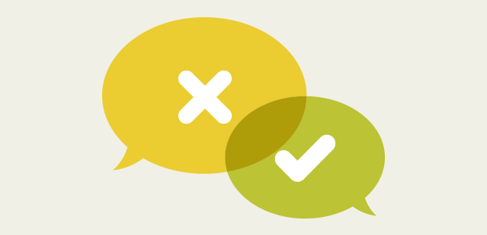
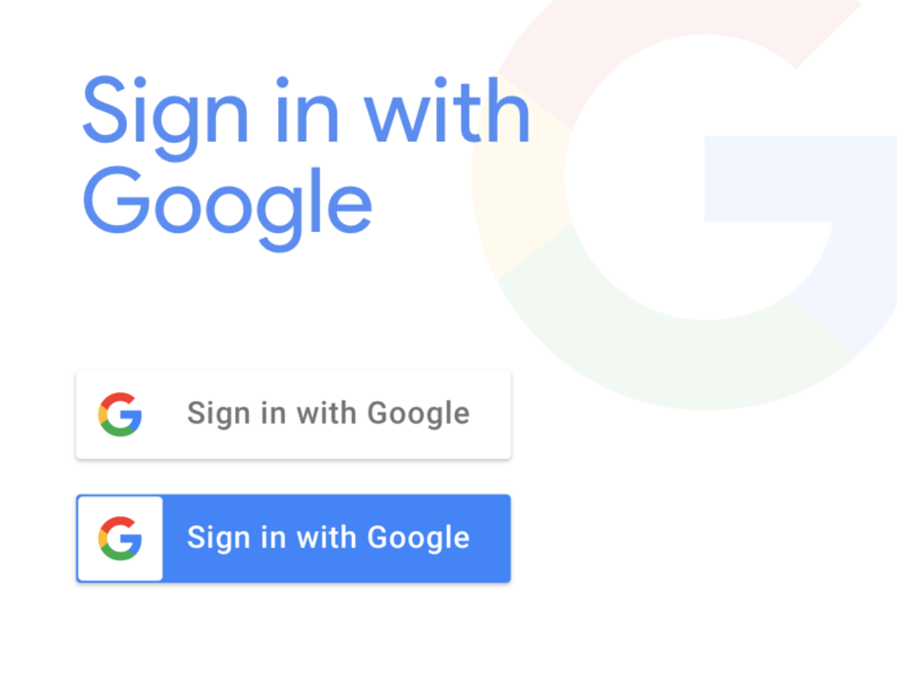
functionalities
Google Authentication:
Our Mini Project has the feature in which user can login with his/her google account.
We have also included Comments which help the reader to convey messages to the writer.

Slide 8

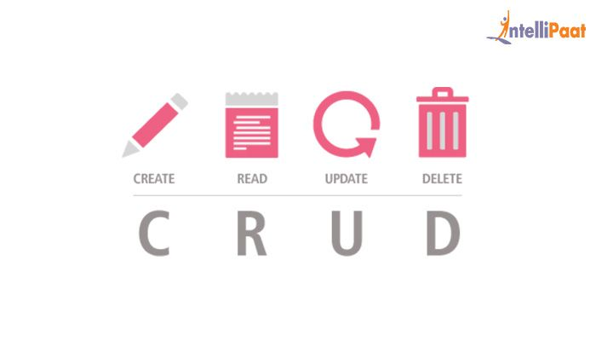
This blog page provides different operations(CRUD):
Create
Read
Update
Delete
There is also an option of Voting by which the reader can express his liking.

Slide 9
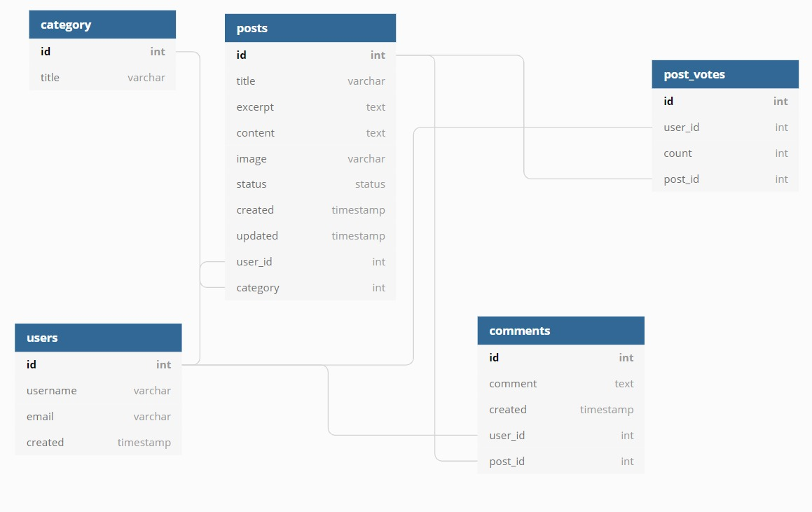
Execution
Database Design:

